Slide 1

Building Shiny Web Apps
With Angular, Typescript, and ASP.NET Core
Dustin Ewers
Consultant @ Centare
Code: https://github.com/DustinEwers/angular-and-dotnet
Website: www.dustinewers.com

Slide 2

Backstory
Notes:
What are we here to do today?
There are so many ways to build a web application. JavaScript is everywhere and there are so many choices.
This talk is about some of the architectural choices when building an Angular App

Slide 3
Roadmap
Angular
Typescript
Monolithic
Serverless
Microservice
Notes:
No need to touch on .NET Core ‘cause Scott already did it.
Going to focus on the basic architecture of Angular and how to mix it up with .NET Core.
By the end, you’ll have a whole slew of ways to build a web app

Slide 4
Angular
Yet Another JavaScript Framework

Slide 5
AngularJS != Angular
Notes:
Angular JS – 2010, great, still supported, but there’s better options
Angular – 2016, great, up and coming

Slide 6
Why?
Modular
Speedy
Well Supported
Complete

Slide 7
Alternatives
React.js
Vue.js
Ember
Popular
Choice Fatigue
Sketchy Licensing
Easy to Learn
Lightweight
Choice Fatigue
Opinionated
Pokey
Longevity

Slide 8
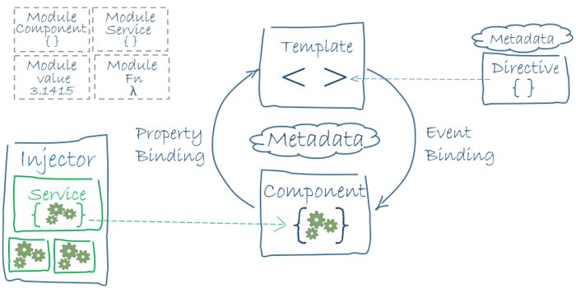
Architecture Overview
Notes:
Angular applications are a series of components and services, housed within modules.
Each component is composed of smaller components and each module is composed of smaller modules.

Slide 9
Typescript
A less horrible version of JavaScript

Slide 10
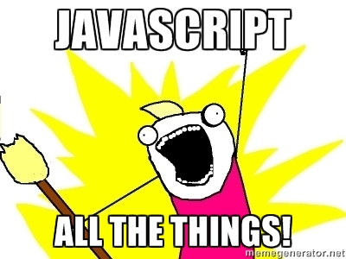
Notes:
The rumors of the web’s death have been greatly exaggerated.
JavaScript (and other web tech) can be used nearly anywhere.
From VR to Microcontrollers, you can program it with JavaScript, but WHY???

Slide 11
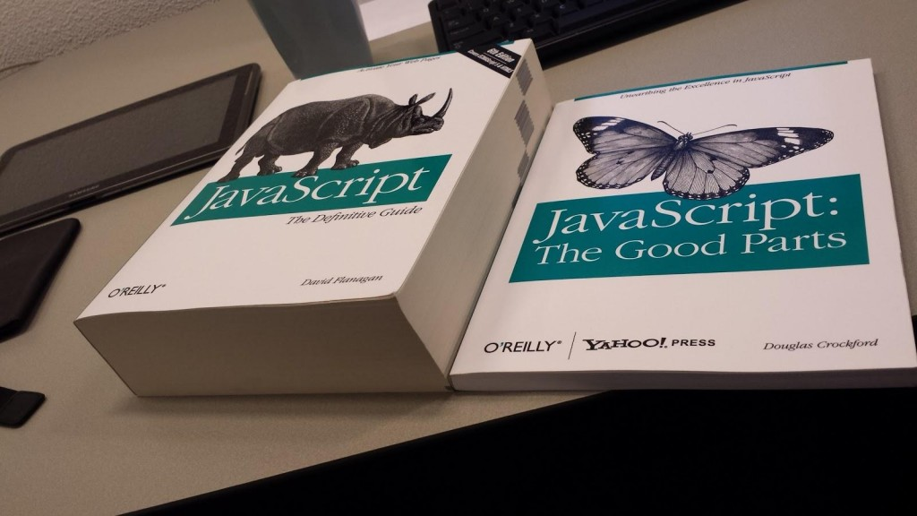
Notes:
JavaScript kinda sucks:
Not great for building large scale applications
No built in modules
No types
Lousy scoping

Slide 12
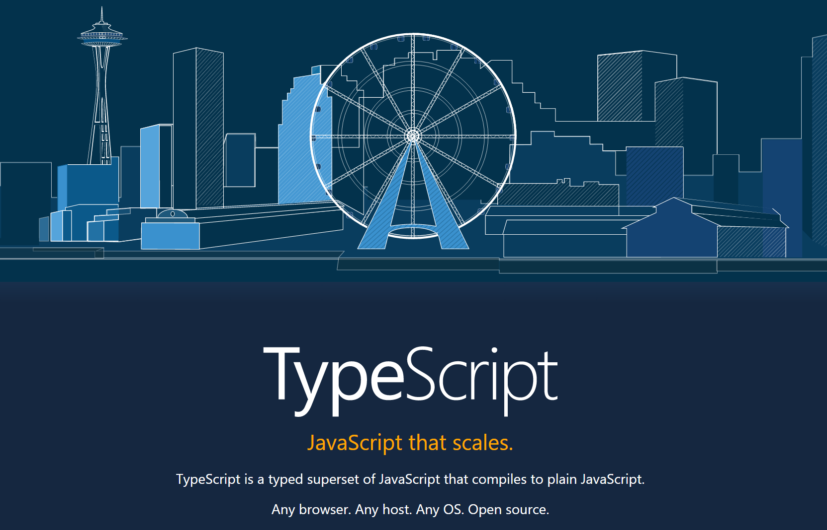
Notes:
TypeScript is JavaScript that scales. It addresses the issues that make large scale JS terrible.

Slide 13
Why?
Classes
Modules
Static Types
Great Tooling
Easy

Slide 14

Monolith Web Apps
Sometimes the old ways are the best ways
Notes:
Photo by Dawn Armfield on Unsplash

Slide 15
Why?
Everything is one place
Easy to refactor
Easy to deploy

Slide 16
Why not?
Scalability Sucks
Complexity
Tight coupling

Slide 17
Demo

Slide 18

Serverless
Servers, we don’t need no stinking servers!

Slide 19
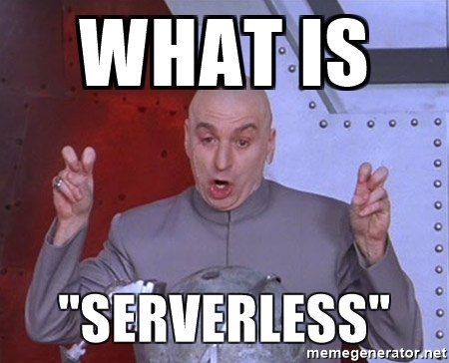
Notes:
Doesn’t mean no servers, just no servers for you to deal with.
Also reffered to as FAAS (functions as a service)

Slide 20
FAAS Providers
AWS Lambda
Google Cloud Functions
Azure Functions
Node.js
Python
Java
.NET Core
JavaScript
Node.js
C#
F#
Python
PHP
Bash
Batch
Powershell
Notes:
This isn’t it. There are lots of other frameworks, including some you can deploy yourself OpenFAAS
https://headmelted.com/serverless-showdown-4a771ca561d2

Slide 21
JAM Stack
JavaScript
APIs
Markup
API
Static Frontend
Notes:
Javascript + API + Markup
https://jamstack.org/
Statically hosted Angular files
Plus some sort of backend like Firebase or a FAAS Provider

Slide 22
Why?
Fast development cycle
Functions abstract the need to manage servers
Easy to scale

Slide 23
Why Not?
Testing
Vendor lock in
Hard to calculate pricing
Notes:
Serverless framework helps with vendor lock in

Slide 24

Microservice
Small is the new big

Slide 25
Microservice Architecture
Service
Frontend
Service
Data
Service
Notes:
It’s a single responsibility service. Applications can be composed of several different services

Slide 26
Why?
Scalable
Maintainable
Reusable

Slide 27
Why not?
Speed
Scoping is hard
More deployments

Slide 28
Scoping
Do This
Not this
Notes:
Try to keep things in vertical slices
Make it easy to rescope services, boundaries change

Slide 29
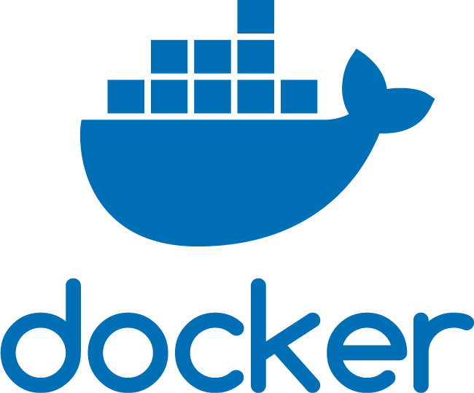
Make it Easy to Deploy
Notes:
You need to make it easy to build and deploy your services
Docker is your friend, as it provides an isolated environments and reproducible deploys
Other CI tools are okay too

Slide 30


Sharing is Caring

Slide 31
Demos

